Slide 1

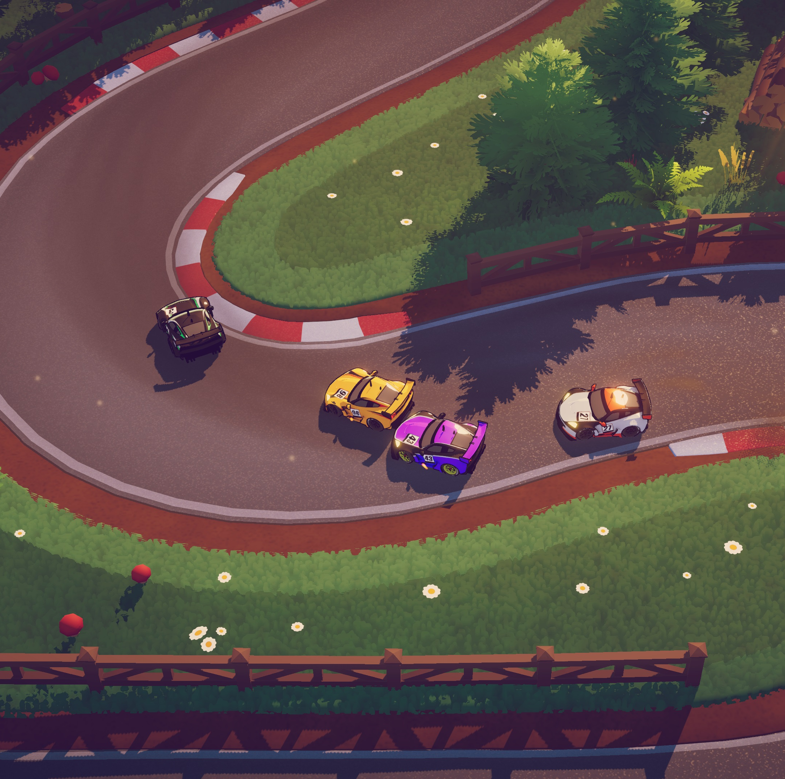

A simple Car Race Game
By Gates Ogork

Slide 2
What was the idea?
A simple car game where users can switch side to side to avoid oncoming traffic on a highway.
This program uses simple python concepts learned in this course such as if, while, and for loops.
Other concepts like imports and linking images as well as animation were used

Slide 3
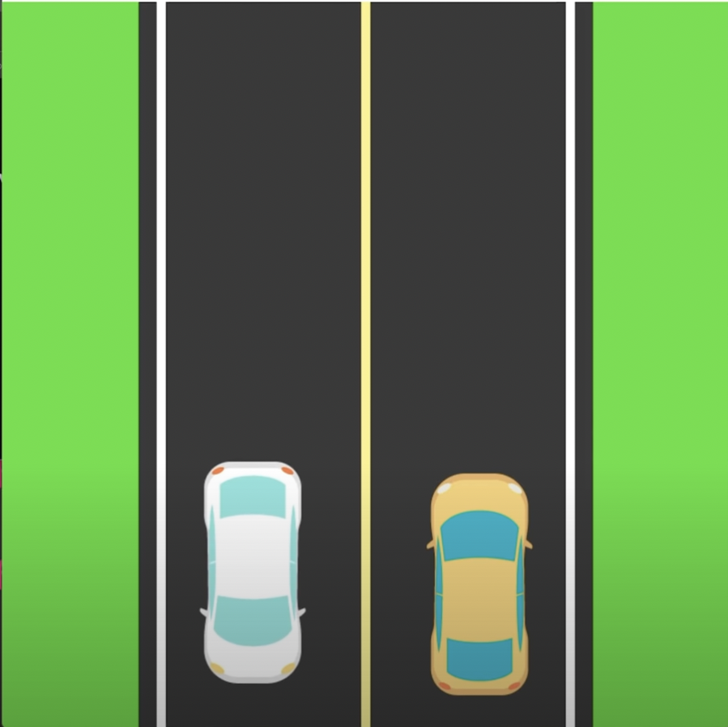
What source code? Or what tutorials did you find?
https://github.com/MariyaSha/SimpleCarGame/blob/main/cargame.py
This is what the end product of the source code looked like

Slide 4
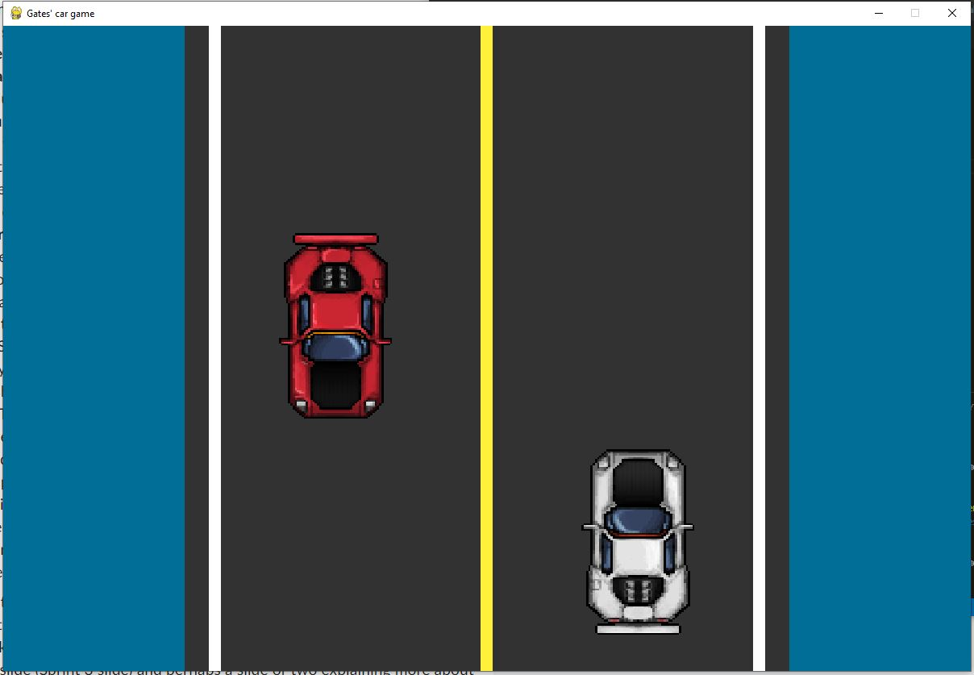
How did your project develop from your initial idea(s) to the end result?
The project completely changed when I found a better source code.
It further developed after I had made improvements to the source code which I used in my final outcome
This is my code outcome

Slide 5
What surprised you? How did the scope change? Why?
Just how much I could do with python, from animating the roads to the water on the side, and even loading images and making them able to work as a real game
The scope changed when I discovered just how much I could do with python
Initially, it was a snake game project but I wanted to make something better so I switched to a simple car game.

Slide 6
What roadblocks did you face? How did you overcome them?
could not run pygame on my computer so I had to code from the school library
Could not figure out how to properly load images
The end function was not working, the enemy car would just go over the user's car
could not figure out how to resize and rotate cars
finding a good color to represent the water
tried to make the window bigger but could not figure that out

Slide 7
Run it/Show the code
Does it run? Show what it can do even if it cannot run. yes it runs

Slide 8
What would you do next?
I would develop a better car game since I found some better ones while doing research to complete this one
I would implement better processes to make the game have more layers, allowing users to do more

